Slide 1

Fundamentals of cloud computing By: Kassandra Moreno

Slide 2


Overview
Virtual Machine Instances
Azure VNet and Subnets
Azure VM Security
Cloud Storage
Cloud Monitoring

Slide 3
Introduction
The following presentation will consist of my introduction to cloud computing. The introduction consists of learning the structure and security of a created virtual machine.

Slide 4
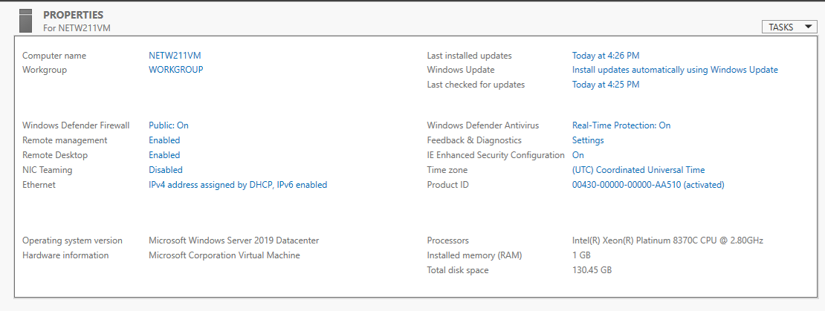
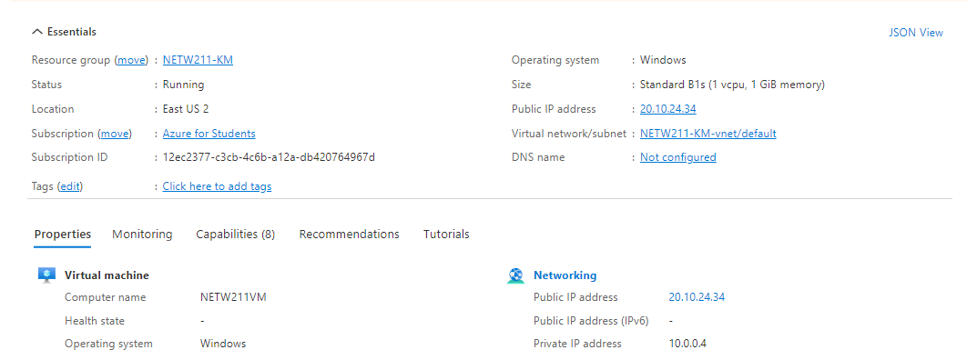
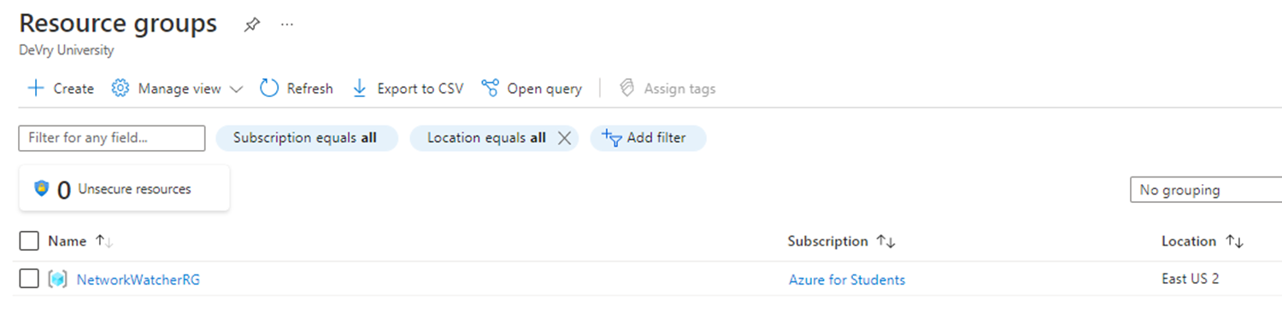
Topic 1: Virtual Machine (VM) Instances
To begin my path in cloud computing it was fundamental to learn how to deploy, connect, and delete a virtual machine.
Deleting the VM
Deploying a VM in Azure
Connecting the VM to a network

Slide 5
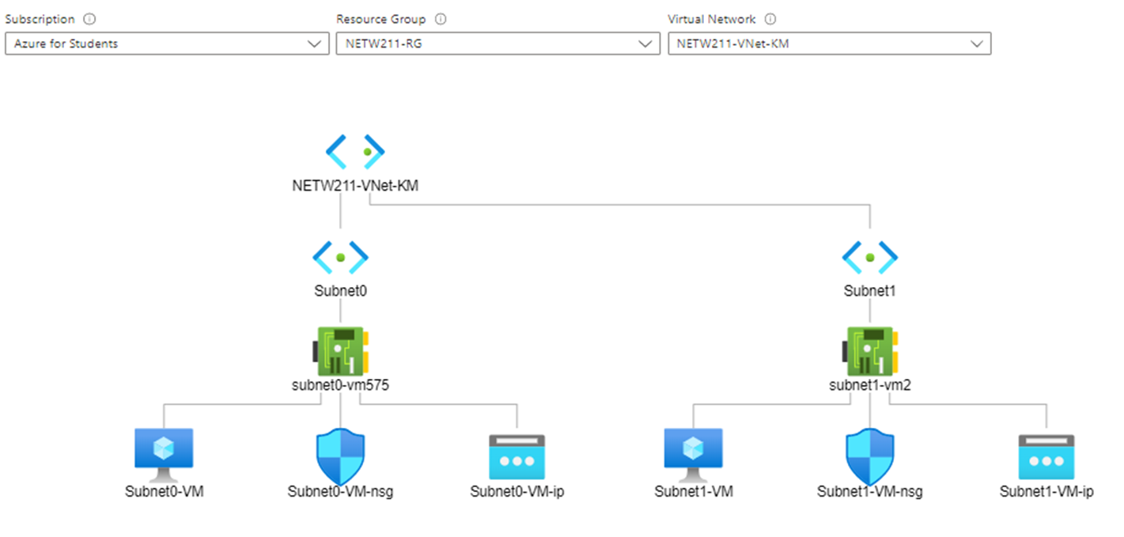
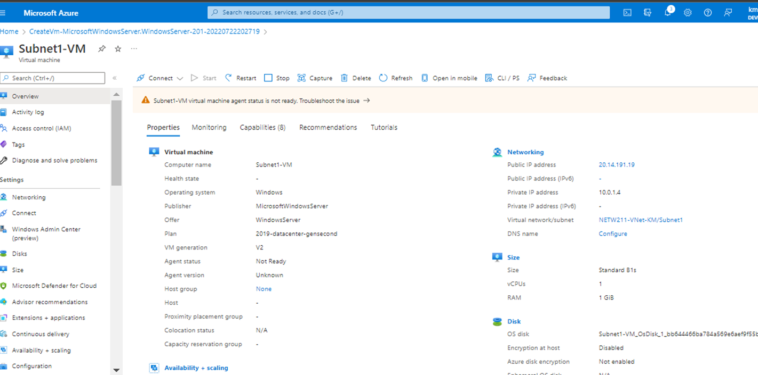
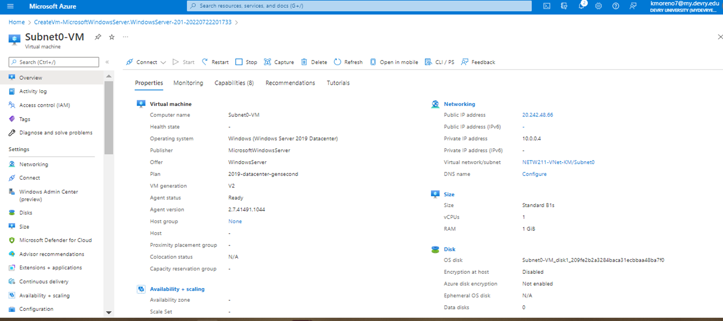
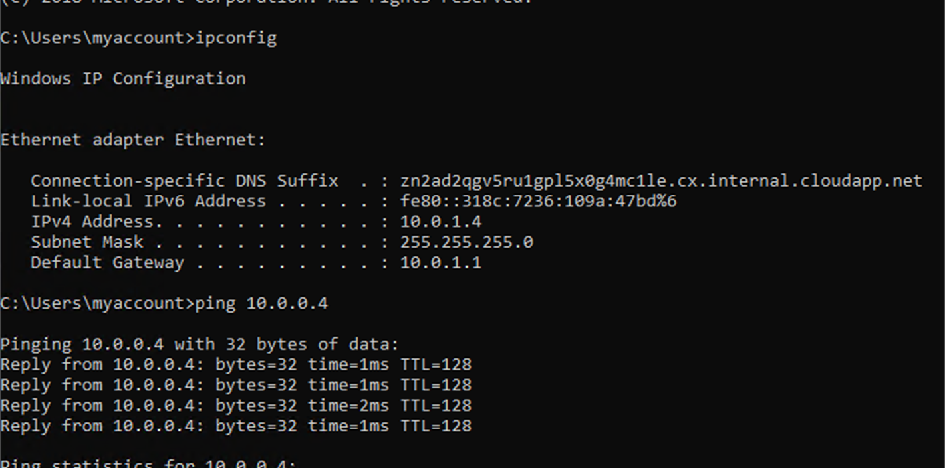
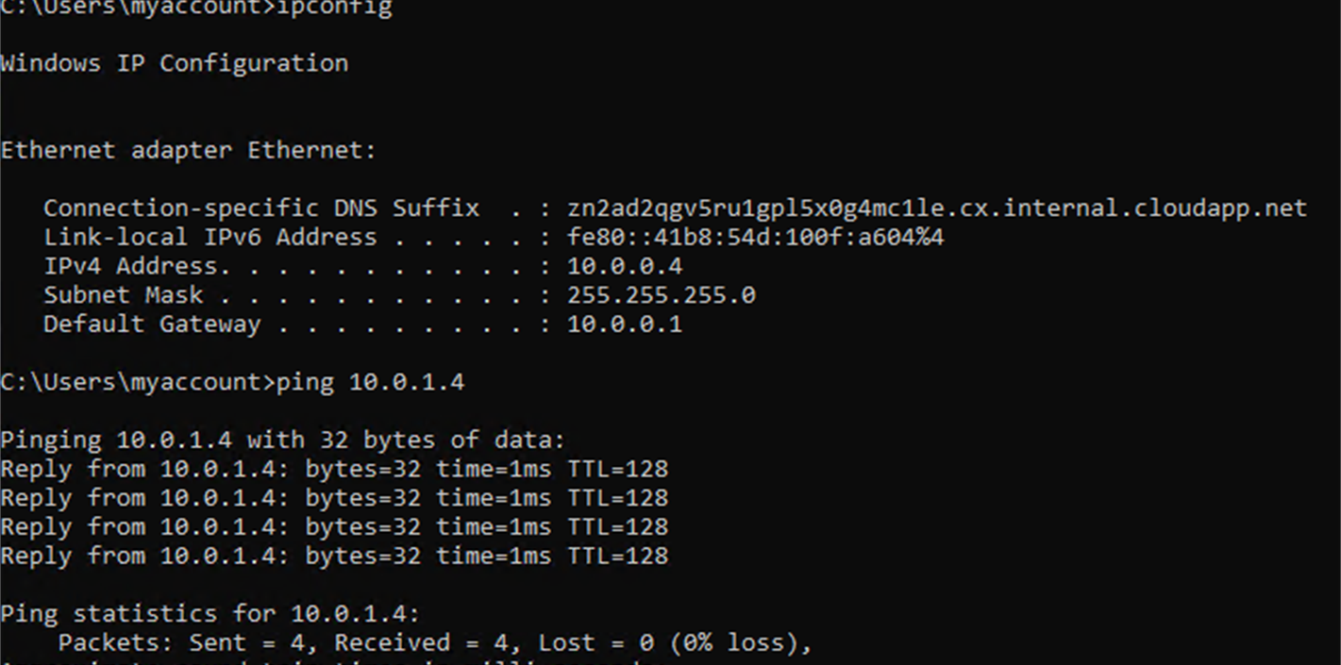
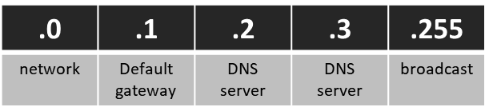
Topic 2: Azure Vnet and Subnets
After Learning how VMs work, the next step was learning how to connect a VNet with two subnets; this entailed deploying VMs into subnets, then confirming connectivity between the VMs.
Confirming Connectivity between VMs
1. With a /24 network prefix, how many usable IPv4 host addresses are there? [hint: you learned this in NETW191]
254
2. Given the answer above, why is the number of available IP addresses for Subnet0 (10.0.0.0/24) or Subnet1 (10.0.1.0/24) shown as 251? [hint: where did the missing addresses go?]
Questions related to creating a VNet with two subnets
Deploying VMs into subnets

Slide 6
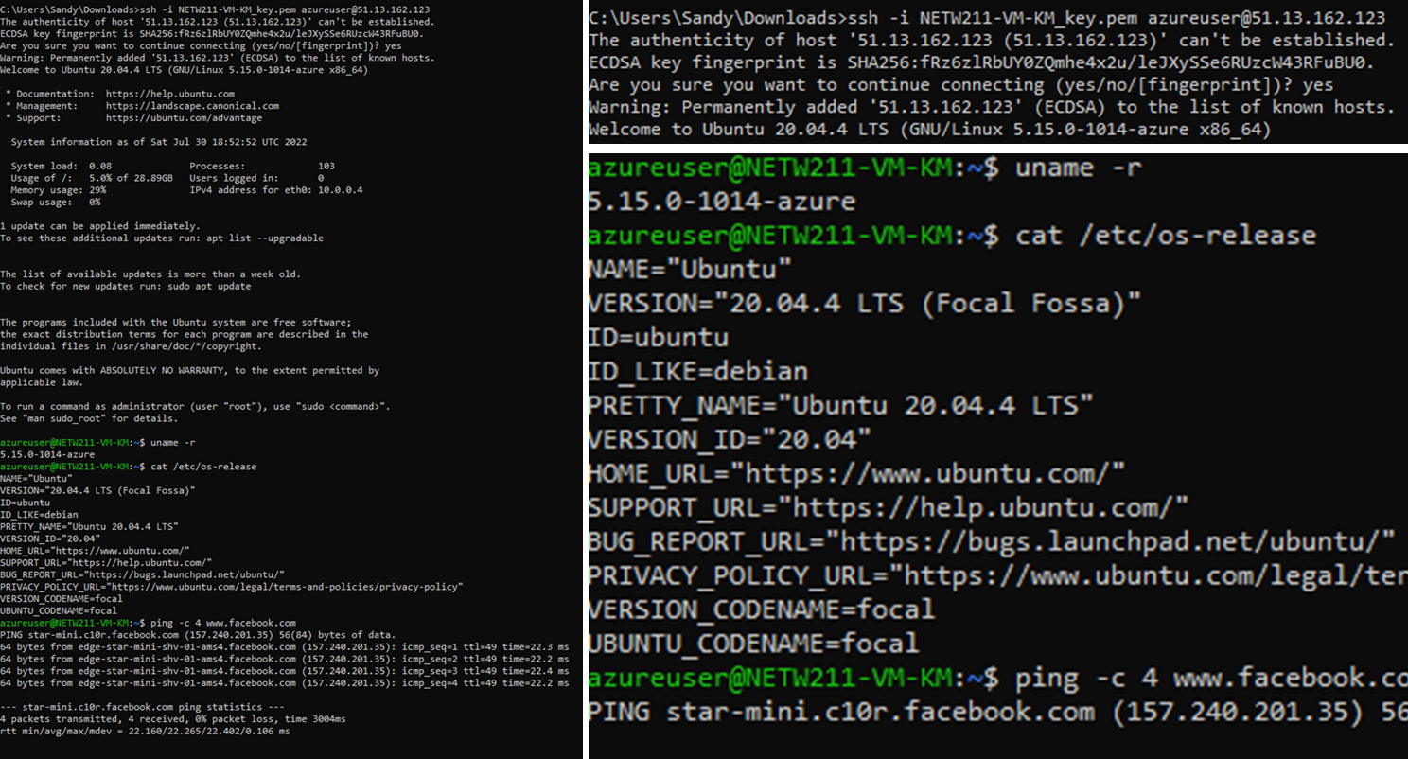
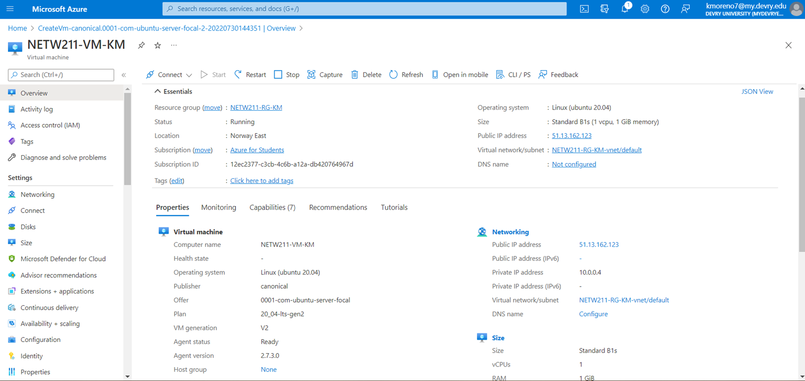
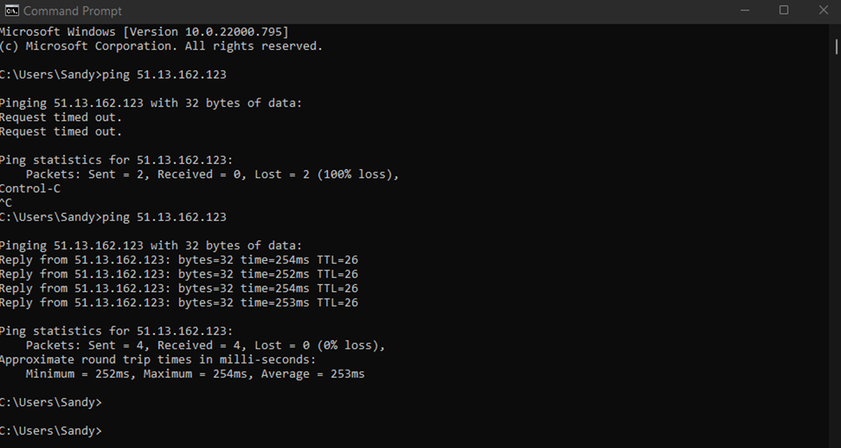
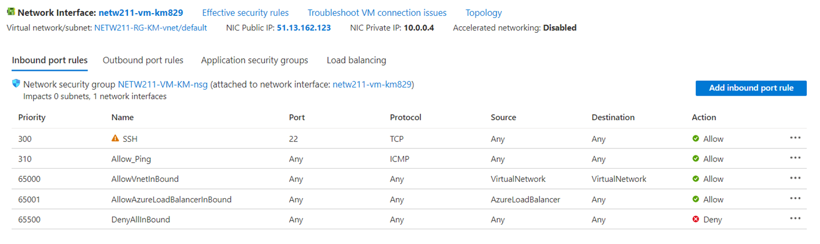
Topic 3: Azure VM Security
Next on in the agenda for cloud computing education was launching a VM, connecting the VM to a SSH (secured shell), and configuring a NSG (network security group).
Configuring an NSG: Successful ping
Adding an Allow Ping rule in order to configure NSG
Connecting to the VM via SSH
Launching VM

Slide 7
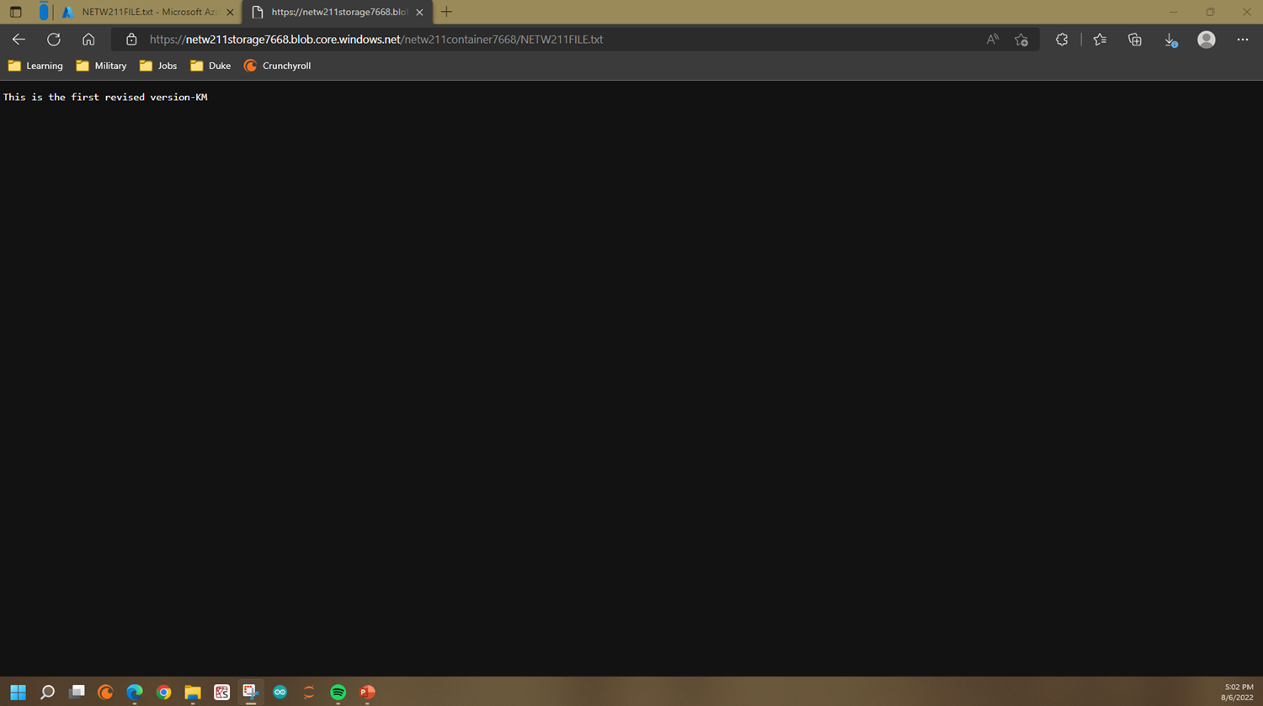
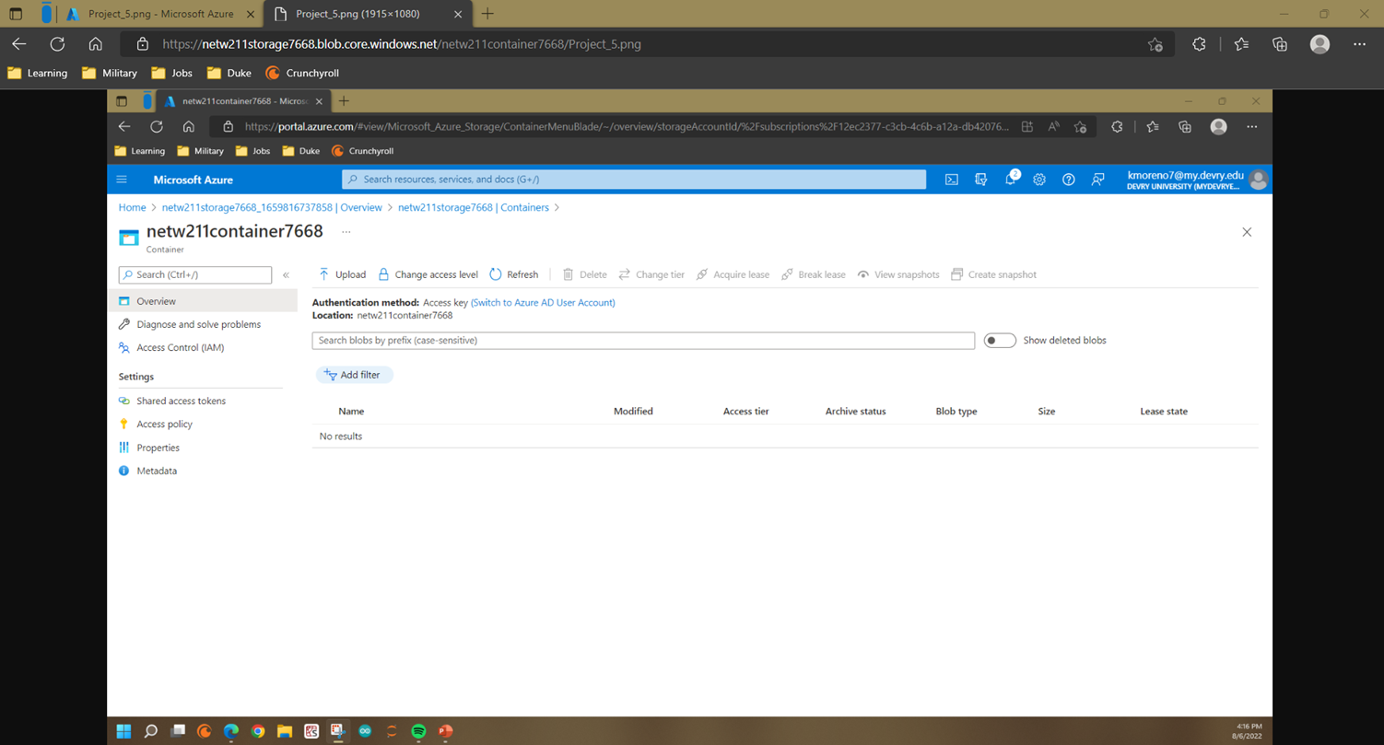
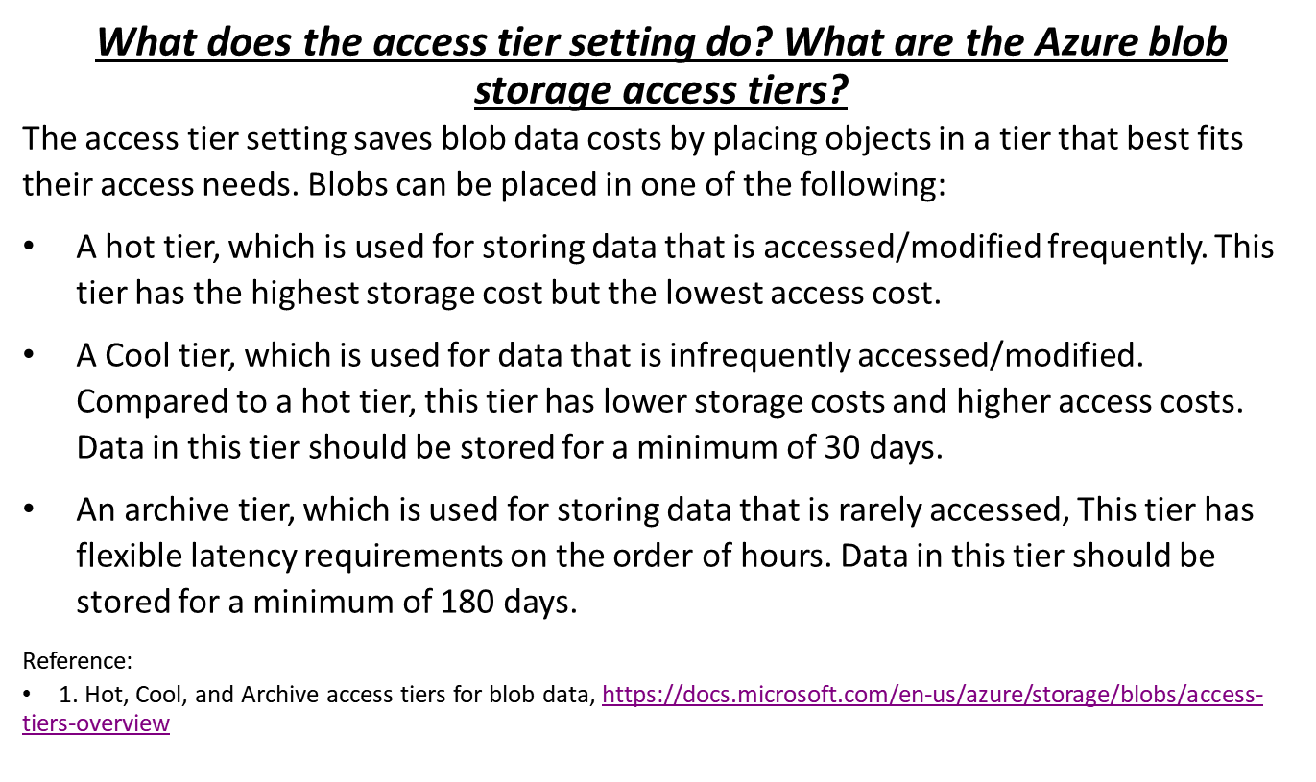
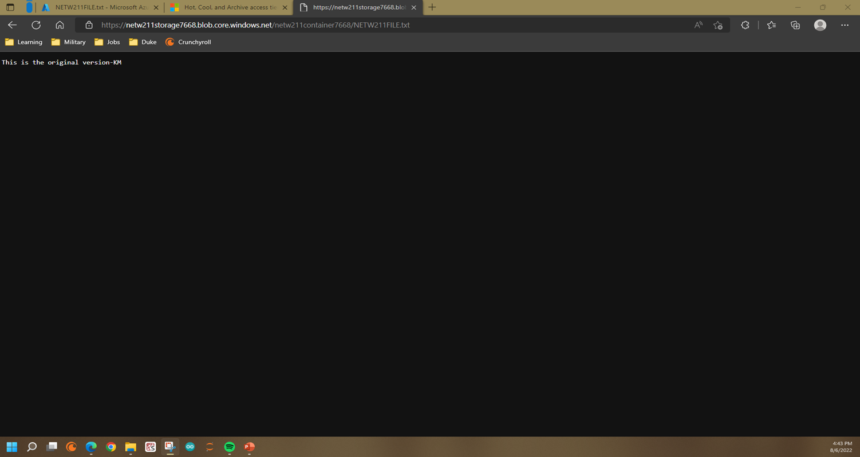
Topic 4: Cloud Storage
After securing my VM, the next step was learning some cloud storage capabilities. Here, I uploaded and accessed a file, created blob snapshots, and enabled blob versioning.
Enabling Code Versioning
Creating Blob Snapshots
Uploading and Accessing a File
Access Tier Settings

Slide 8
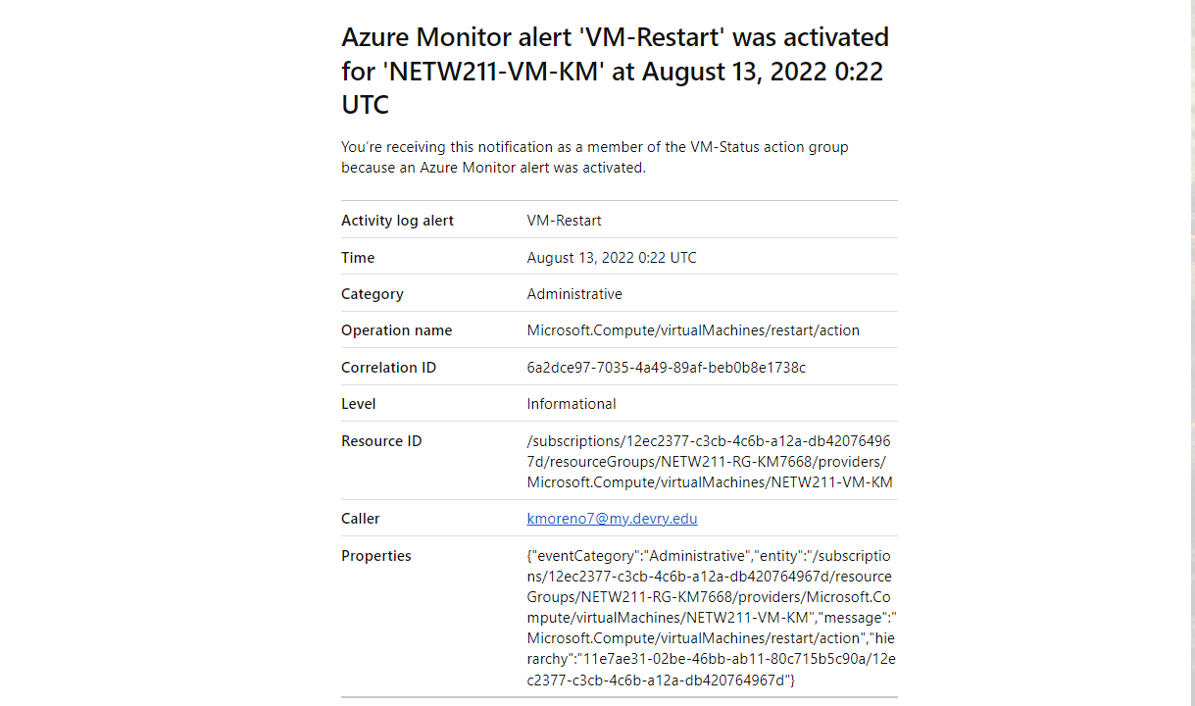
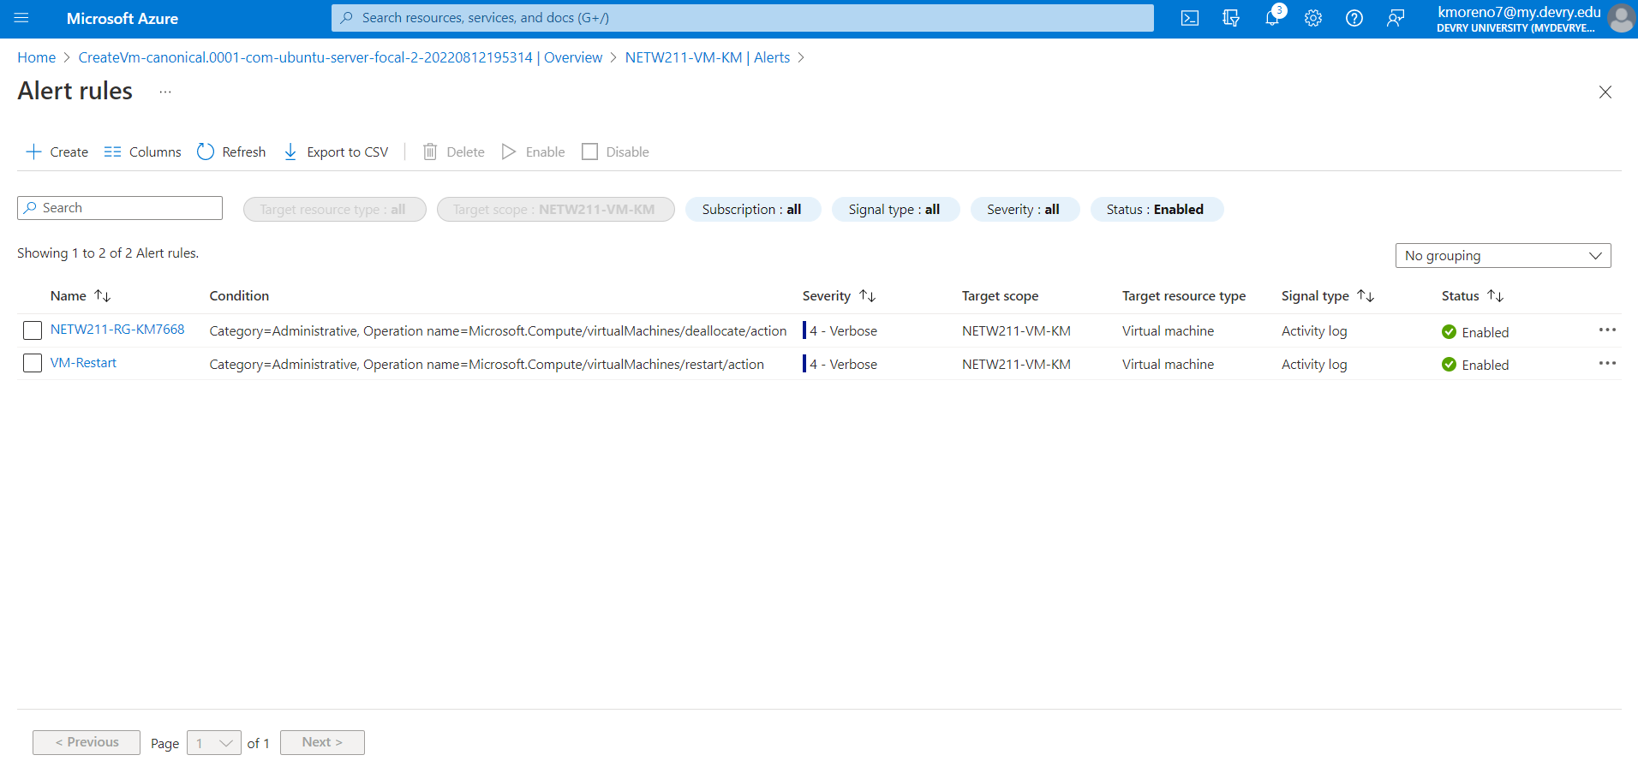
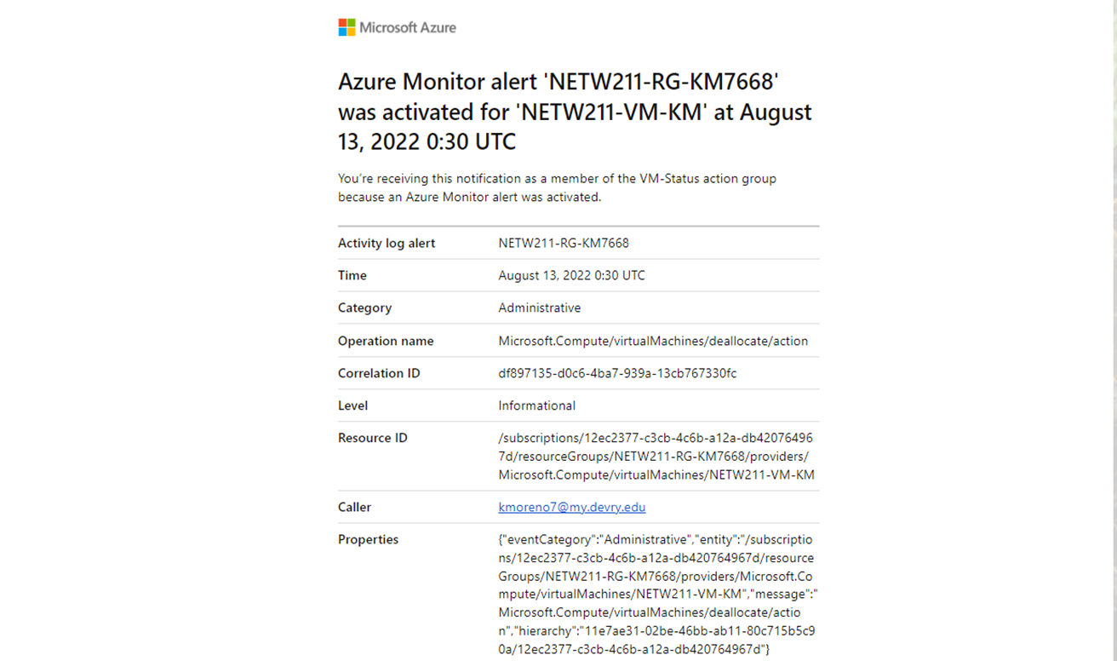
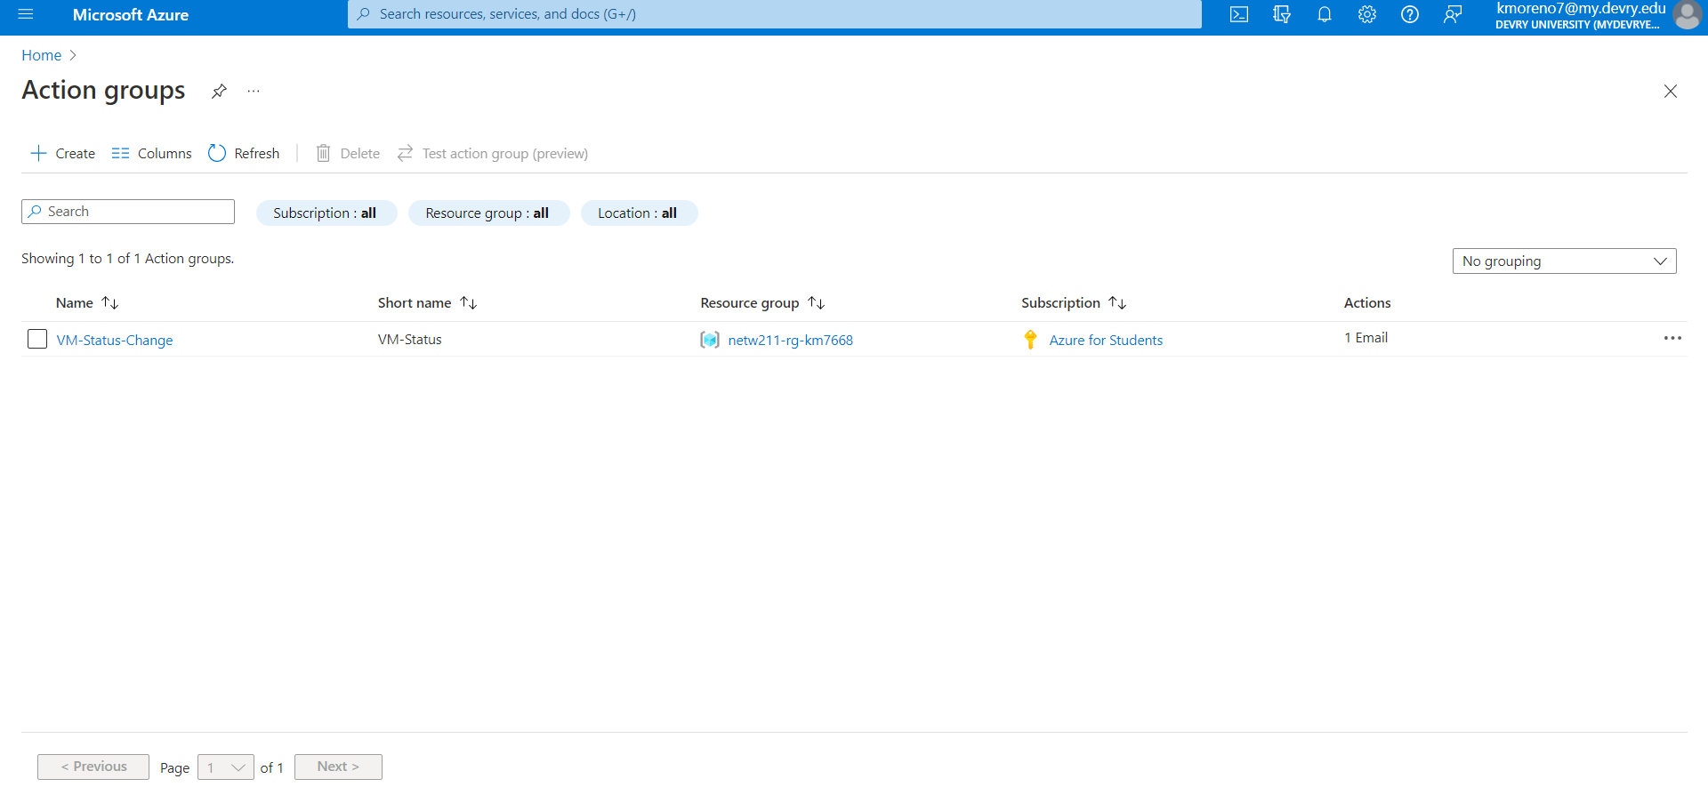
Topic 5: Cloud Monitoring
Following the set up of cloud security is cloud monitoring. To monitor my data I set up action groups, notifications, alert rules, and tested the alerts.
Testing Alerts
Setting Up Alert Rules
Setting Up Action Group and Notification

Slide 9
Summary
In this PowerPoint, I have briefly summarized my learning path regarding cloud computing. This path included starting a VM, connecting VNet and subnets, ensuring VM security, managing cloud storage, and initiating cloud monitoring.

Slide 10
Challenges
Since this was my introduction to cloud computing, I would say my greatest challenge was absorbing so many complex concepts in a short period. I would not say that the course is next to impossible, but I will admit that it requires uninterrupted focus.
My most challenging project would have fallen under my Topic 2 PowerPoint: Azure Vnet and Subnets. My specific complication was understanding the reason for the number of available IP addresses. The misunderstanding was solved when I looked into what addresses were reserved.

Slide 11
Career skills Obtained
In today’s day and age, I will not fail to see how vital my lessons through this project have been. Cloud computing is our next move in the IT industry, and this course has taught me the fundamentals necessary to begin a path in cloud computing. A few career skills and concepts I have learned through this period would be:
Navigating Azure Labs and understanding its VM environment.
Cloud security and storage concepts and capabilities.
Cloud migration and performance monitoring

Slide 12
Conclusion
This concludes my presentation, which went through creating, structuring, securing, and monitoring a VM (virtual machine).

